Slide 1
Front End Engineering-I Project
Team Details: Harsainyam Singh(2310991840)
Harshdeep Singh(2310991841)
Harshdeep Singh(2310991842)
Faculty Coordinator: Dr.Bhisham Sharma
:
Chitkara University Institute of Engineering and Technology,
Chitkara University, Punjab

Slide 2
Table of Contents
Introduction
Problem Statement
Technical Details
Key Features
Project Highlights
Bonus Feature(optional)
Conclusion
References/Links used

Slide 3
Introduction
Welcome to our recipe website! Here, you can find and share all sorts of delicious recipes. It doesn't matter if you're a pro chef or just starting out in the kitchen – everyone is welcome. Explore a wide variety of recipes, connect with other food lovers, and enjoy the fun of cooking and sharing your favorite dishes. Get ready to discover new flavors and recipes from around the world, all in one place!
Community Engagement: Connect with fellow food enthusiasts, share your culinary creations, and exchange tips and tricks. You can leave comments, rate recipes, and even create your own virtual recipe book.
User-Friendly Interface: Our website is user-friendly and easy to navigate. Search for recipes, filter by ingredients, or explore trending dishes with just a few clicks.

Slide 4
Introduction
why Need A Recipe Website?
A food sharing website serves as a valuable platform for a variety of reasons, contributing to an enriched culinary experience and fostering a sense of community among food enthusiasts. Here are several compelling reasons for the need for a food sharing website:
Community Building:
Networking: A sharing website brings together individuals with a common interest in food, creating a vibrant online community. Users can connect, share experiences, and build relationships based on their mutual love for culinary exploration.
2. Knowledge Exchange:
Learning Opportunities: By allowing users to share their recipes, tips, and tricks, a food sharing website becomes a hub for knowledge exchange. Novice cooks can learn from experienced chefs, fostering a continuous learning environment.

Slide 5
Introduction
3Diverse Culinary Exploration:
Recipe VarietyA sharing platform facilitates the exchange of a wide range of recipes from different cuisines, dietary preferences, and skill levels. This diversity provides users with a plethora of options, encouraging them to try new dishes and broaden their culinary horizons.
4. Inspiration and Creativity:
Creativity Boost: Seeing and trying out recipes from other users can inspire creativity in the kitchen. Users may be encouraged to experiment with ingredients, techniques, and presentations, leading to the development of unique and innovative dishes.
5. Personalized Collections:
User ProfilesA food sharing website typically allows users to create personalized profiles where they can curate their favorite recipes. This feature enables individuals to build a digital collection of recipes tailored to their taste preferences and cooking style.

Slide 6
Introduction
Share Your Masterpieces: Join our community of food enthusiasts and share your own delicious creations with step-by-step instructions, photos, and cooking tips.
Recipe Categories: Browse through a diverse range of recipe categories, from comfort food classics to exotic international cuisines, ensuring there's something for every palate.

Slide 7
Problem Statement
People often struggle to find and share recipes in a convenient way. This makes it hard to try new dishes, connect with others who love cooking, and keep their kitchen adventures organized.
Many food lovers struggle with the hassle of finding recipes that suit their tastes and dietary preferences, organizing their favorite dishes in one place, and easily sharing their culinary creations with friends and family.
This lack of an efficient and user-friendly recipe sharing platform limits their ability to explore diverse cuisines, learn from others, and make the most of their cooking experience.

Slide 8
This lack of an efficient and user-friendly recipe sharing platform limits their ability to explore diverse cuisines, learn from others, and make the most of their cooking experience. On internet Finding recipes is as difficult as finding needle in a haystack. There aren’t many stable platform to share all recipes whether it is video recipes or written recipes. Out there are not many recipe generators which give you recipes based on user given ingredients.
The absence of a reliable mechanism to assess recipe quality poses a significant challenge. Users often struggle to discern the credibility and appeal of a recipe, resulting in a hesitation to try new dishes. Establishing a trustworthy environment where users can confidently explore and experiment with recipes is paramount to the success of a recipe sharing platform.
We want to make this easier for the users to share recipes online, and we accepted this challenge to find a way to simplify recipe sharing online, making it accessible to everybody and everyone.

Slide 9
Technical Details
WEB DEVELOPMENT STACK: THE TECHNOLOGY THAT WE HAVE USED IN THIS WEBSITE IS TYPICALLY HTML AND CSS FOR THE FRONT END PART.
SEARCH :WE HAVE CREATE A SEARCH FUNCTIONALITY TO HELP USERS FIND RECIPES BASED ON INGREDIANTS.
RECIPE SUBMISSION: DEVELOP A FORM FOR USER TO SUBMIT THERE RECIPES.
USER AUTHENTICATION: WE HAVE IMPLEMENT USER REGESTRATION TO ALLOW USER TO CREATE ACCOUNT,SIGN IN AND SECURILY MANAGE THERE PROFILE.
RECIPE GENERATOR: THIS METHOD HELPS USER TO GET A RECIPE FROM THE INGREDIENTS THAT USER HAVE .USER WILL ENTER THEIR INGREDIENTS TO GET A RECIPE.

Slide 10

Technical Details
FRONT END -:
HTML(Hypertext Markup Language)-: HTML is the base of our main website .It is Used to make the structure of a website which include different tags.
HTML5-: Html5 is just html but with added features such as audio video support.

Slide 11

Technical Details
CSS(Cascading style sheet)-: Css is used for styling our structure made by HTML, such as adding colors , styles, animations and much more.

Slide 12
Technical Details
RESPONSIVE DESIGN-:
To make sure that our website is working on every single device responsive web design methods were used. Because of these methods our website can adapt to desktop, tablet, mobile phones laptops etc.
INTERACTIVE USER INTERFACE-:
Our user interface was designed with user experience in mind.This includes user friendly recipe sharing forms for recipe submission and search function to make it easy to find recipes. There are much more interactive things on our website to make sure user enjoys each and every moment on our website.
FILE ORGANISATION-:
Files of our website were organized into different categories , and maintained properly by adding different files into different folders so that it is easy to modify or change the content of our website.

Slide 13
Technical Details
HYPERLINKS AND NAVIGATION-:
All Hyperlinks and navigation were created in html to help user navigate through different pages. Proper link structures ensures a smooth browsing experience.
BROWSER COMPATIBILTY-:
FoodZee was tested in various web browsers (e.g., Chrome, Firefox, Safari, and Edge) to ensure it functions correctly and looks good across the board.
TAGS USED IN THIS WEBSITE-:
Title tag 2.Division tag 3.Anchor tag 4.Hyper reference tag
5.Image tag 6.Video tag 7.Font tag 8.Hr tag 9.Marquee tag
10.Heading tag 11.Footer tag 12.Table tag 13.External CSS 14.Internal CSS
15.Inline CSS

Slide 14
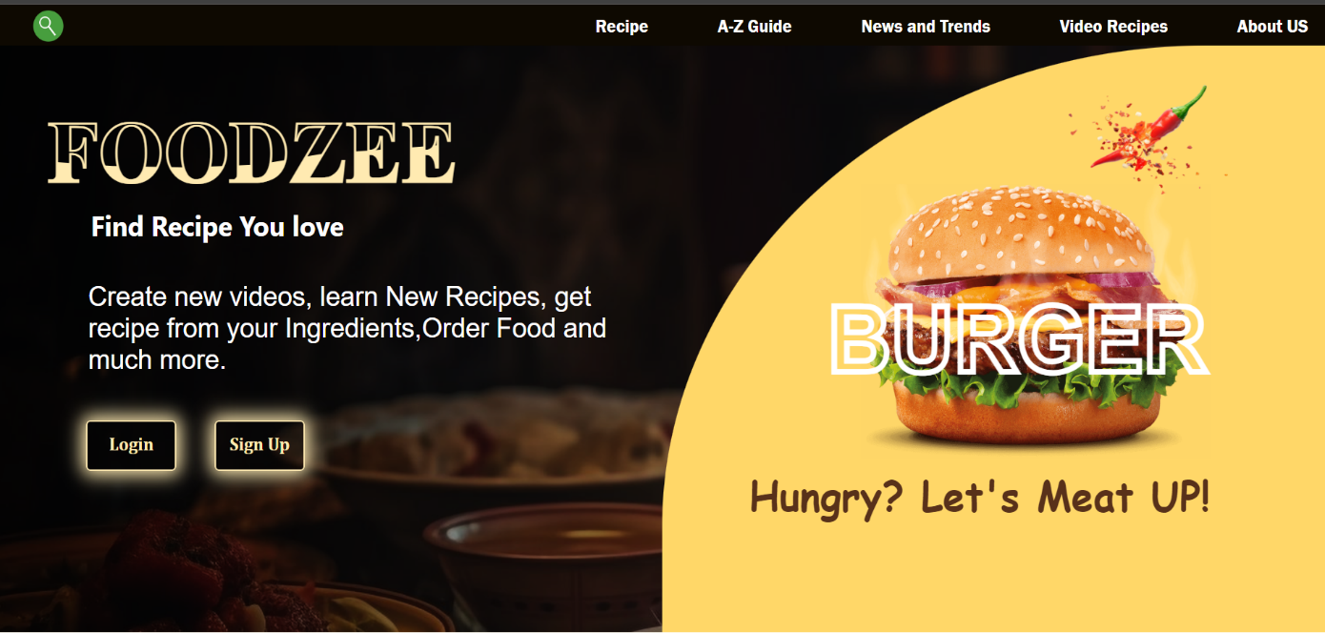
Technical Details
The home page of our recipe sharing website, crafted with a seamless blend of HTML, CSS, and JavaScript, is designed to captivate users from the moment they land on the site.

Slide 15
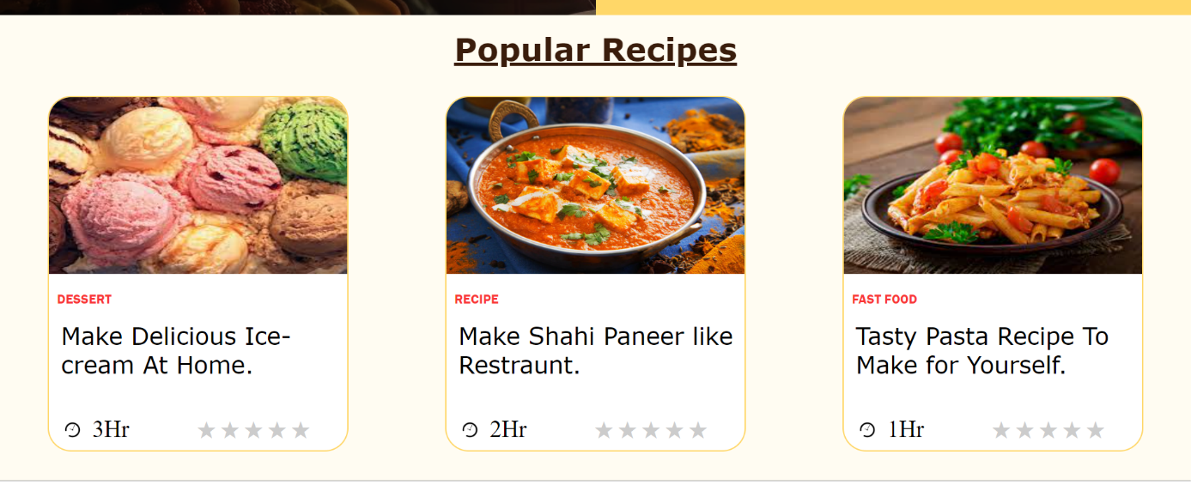
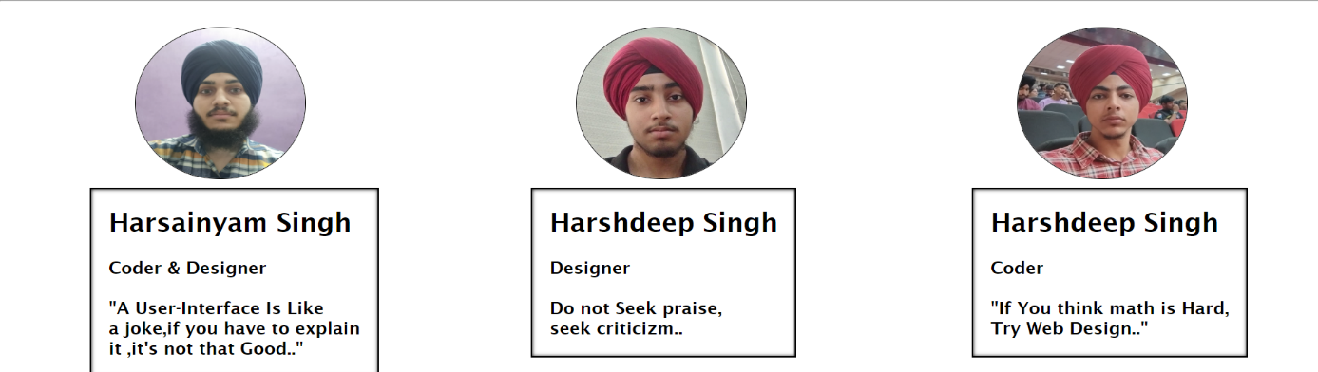
Technical Details

Slide 16
Technical Details
News And Trends-:
In the dynamic world of culinary exploration, staying abreast of the latest news and trends is essential for every passionate home cook. Our recipe sharing website recognizes the importance of not only providing an extensive collection of mouthwatering recipes but also keeping our community informed and inspired. The "News and Trends" page serves as a virtual culinary newspaper, delivering a delectable blend of food-related updates, emerging trends, and insightful articles to nourish the minds of our users.

Slide 17
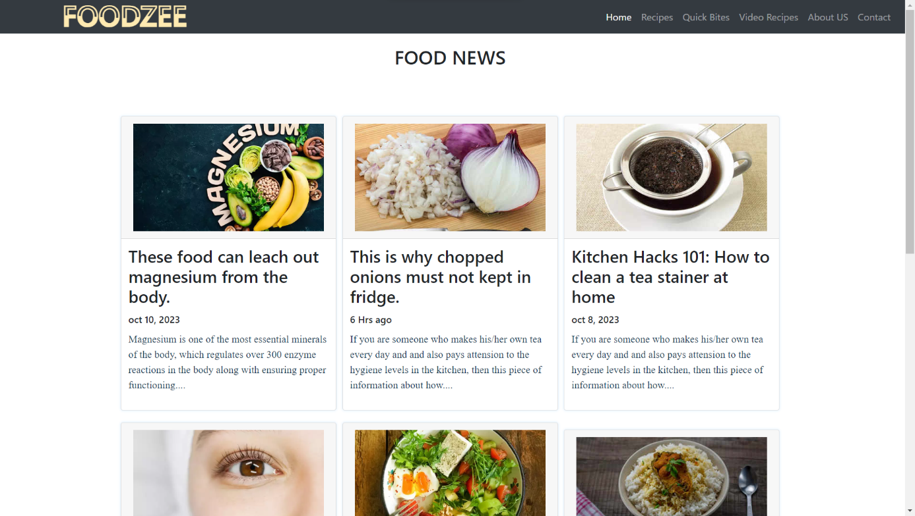
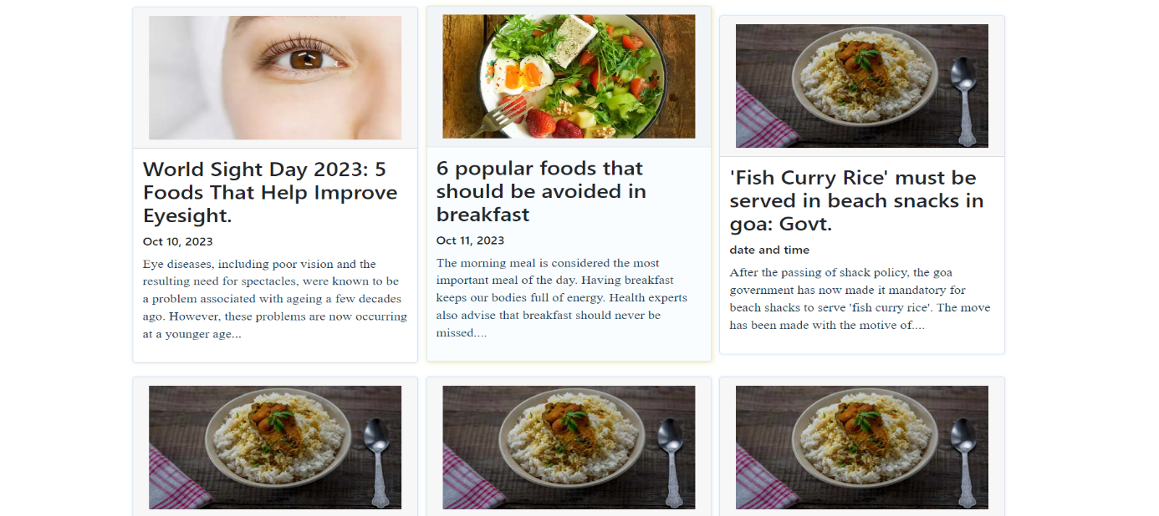
Technical Details

Slide 18
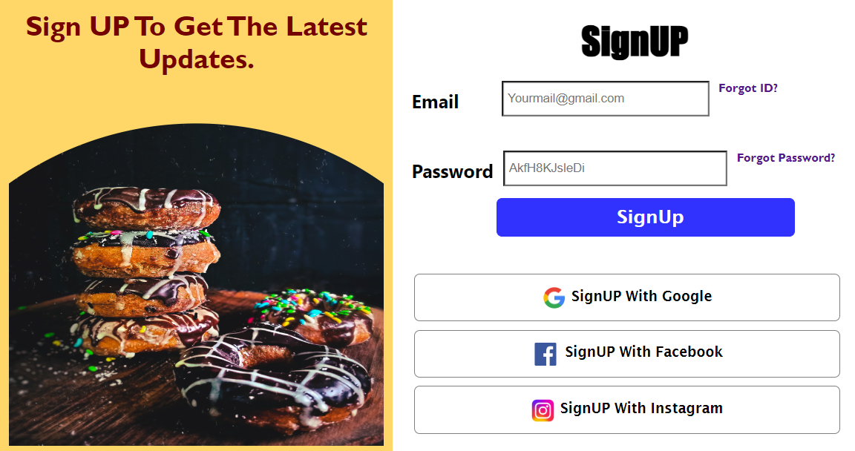
Technical Details
Login And Sign UP Page:
This page is designed to collect contact information from potential customers, such as their name, email address, and phone number. A user should enter Firstname, Secondname, Email and Password. "Reset" and "Submit" button have been provided.In this page, JavaScript has been used to make the page operational.

Slide 19

Technical Details
The footer of our recipe sharing website is a subtle yet essential component that adds the finishing touch to the user experience. Crafted with attention to detail, the footer serves as a navigational anchor, providing users with quick access to essential links such as the terms of service, privacy policy, and contact information. It is designed for both functionality and aesthetics, featuring a clean and minimalist layout that complements the overall visual appeal of the website.

Slide 20
Technical Details
BreakFast Page-:
he Breakfast page is a sunrise symphony of recipes, celebrating the most important meal of the day. From energizing smoothie bowls and wholesome overnight oats to indulgent brunch classics like avocado toast or fluffy pancakes, this page inspires users to kickstart their mornings with a burst of flavor and nourishment. Nutrient-packed options and creative twists on breakfast staples ensure there's something for everyone, whether you prefer a quick grab-and-go option or a leisurely weekend feast.
Lunch Page-:
As the sun reaches its zenith, our Lunch page takes center stage, offering an array of culinary creations suitable for midday indulgence. From vibrant salads and hearty sandwiches to international delights like sushi bowls or Mediterranean wraps, users can find diverse lunch options to suit various palates and dietary preferences. The page emphasizes convenience without compromising on taste, providing practical and delicious solutions for busy individuals.

Slide 21
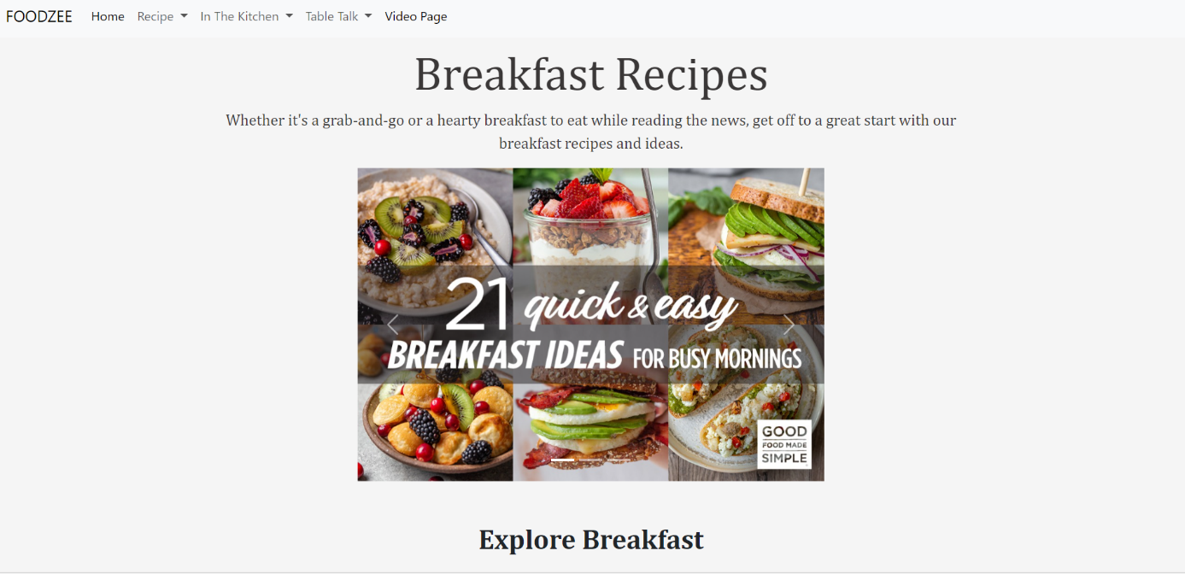
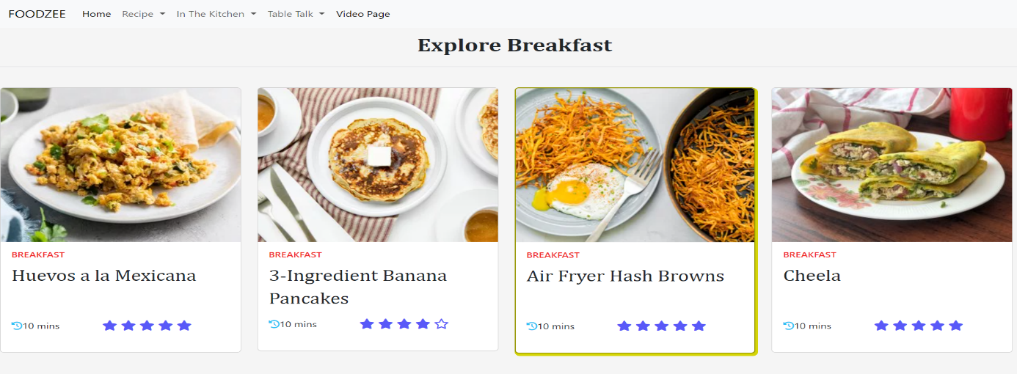
Technical Details

Slide 22
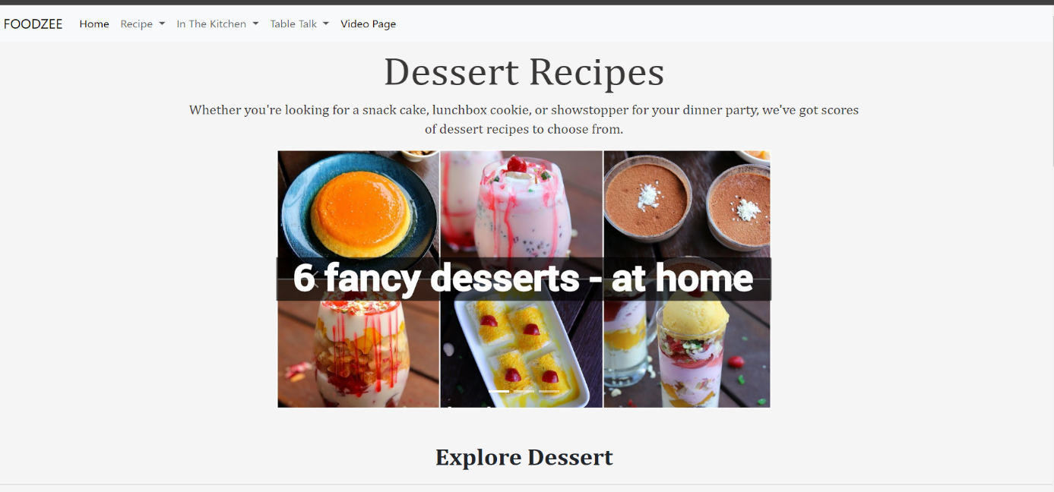
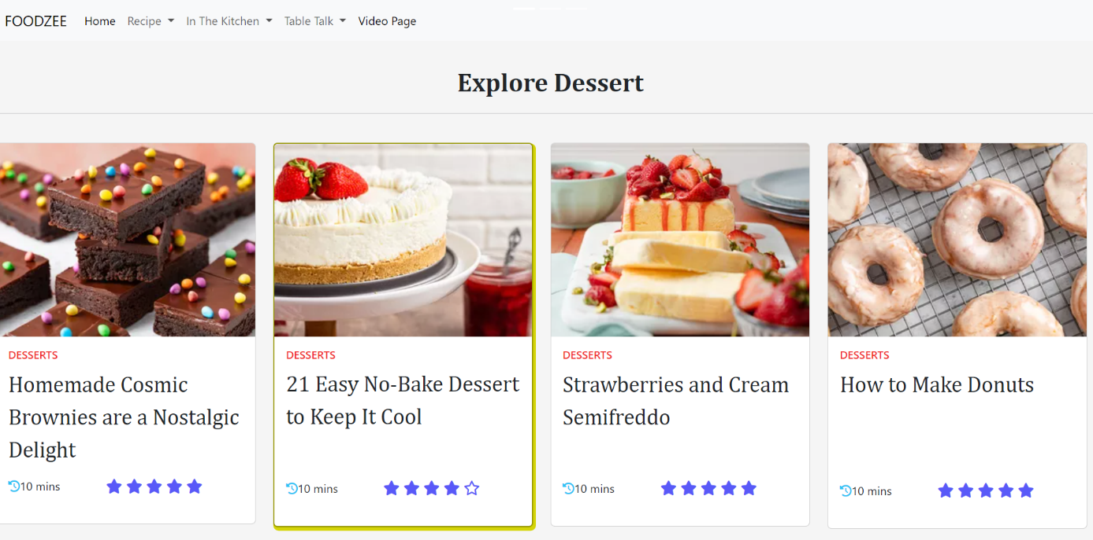
Technical Details

Slide 23
Technical Details
Dinner Page-:
As day turns to night, the Dinner page becomes a canvas for culinary artistry. Elegant mains, comforting sides, and decadent desserts grace this page, catering to both weeknight dinners and special occasions. From savory pasta dishes and aromatic curries to succulent grilled entrees, the Dinner page invites users to transform their evenings into memorable culinary experiences. Clear instructions and beautiful imagery guide users through the creation of restaurant-quality dinners in the comfort of their homes.
Drinks Page-:
Our Drinks page is a liquid symphony, offering a diverse array of beverages to complement any meal or satisfy a particular craving. From refreshing smoothies and energizing coffees to sophisticated cocktails and soothing teas, this page is a treasure trove for beverage enthusiasts. Users can explore recipes for every mood and occasion, whether they're seeking a morning pick-me-up, a refreshing afternoon sip, or a sophisticated evening concoction.

Slide 24
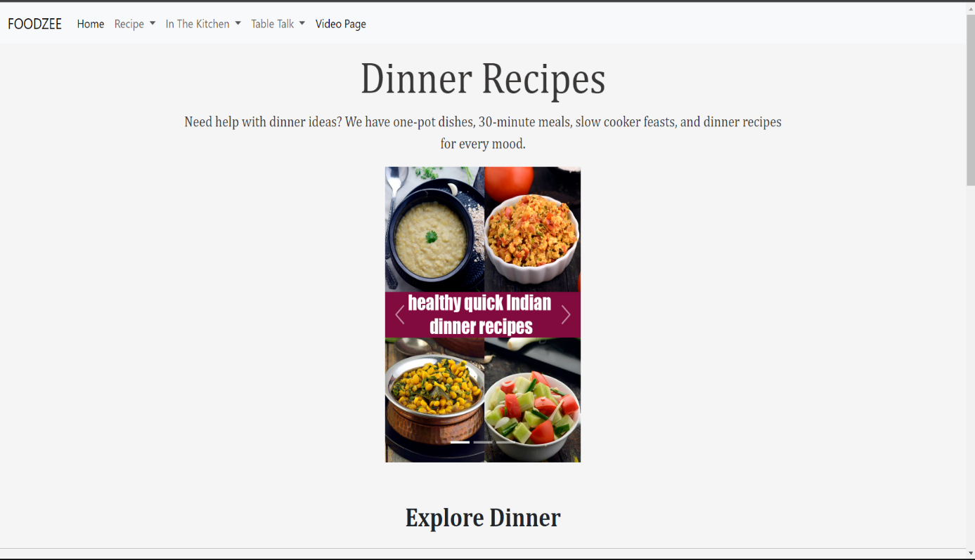
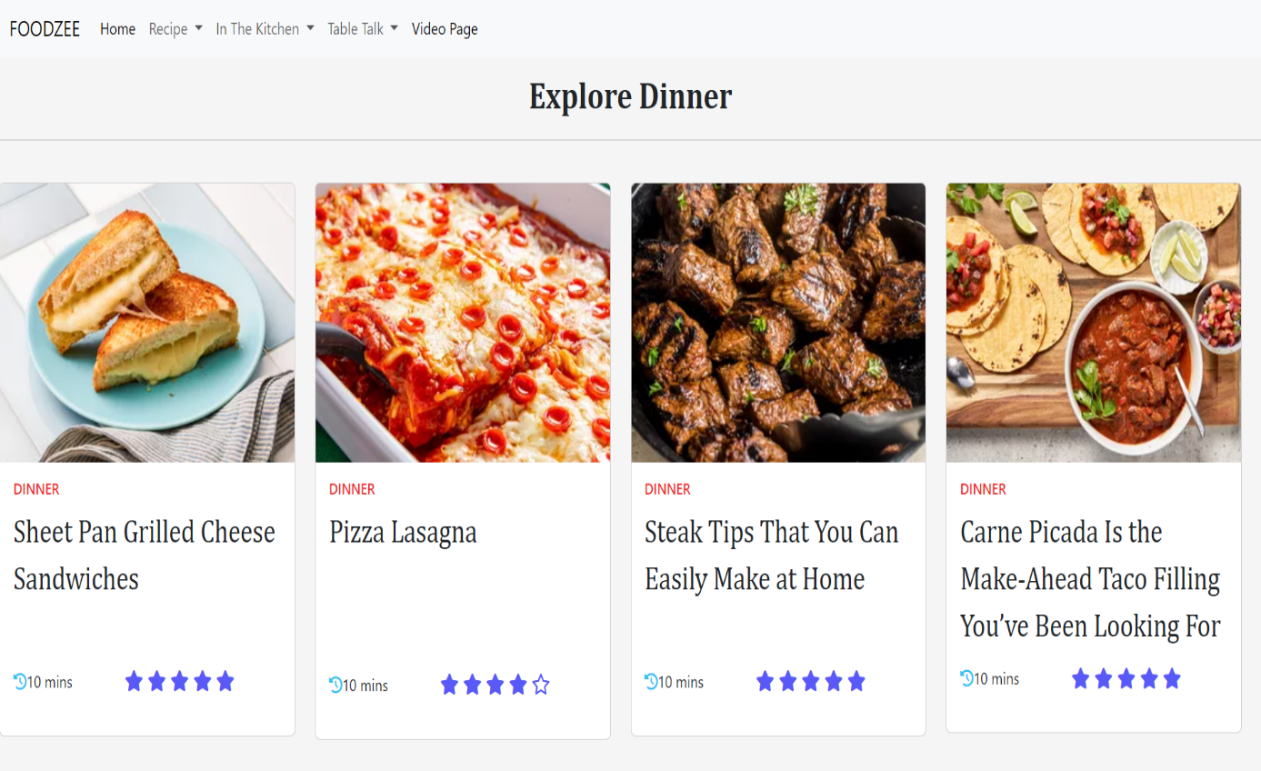
Technical Details

Slide 25
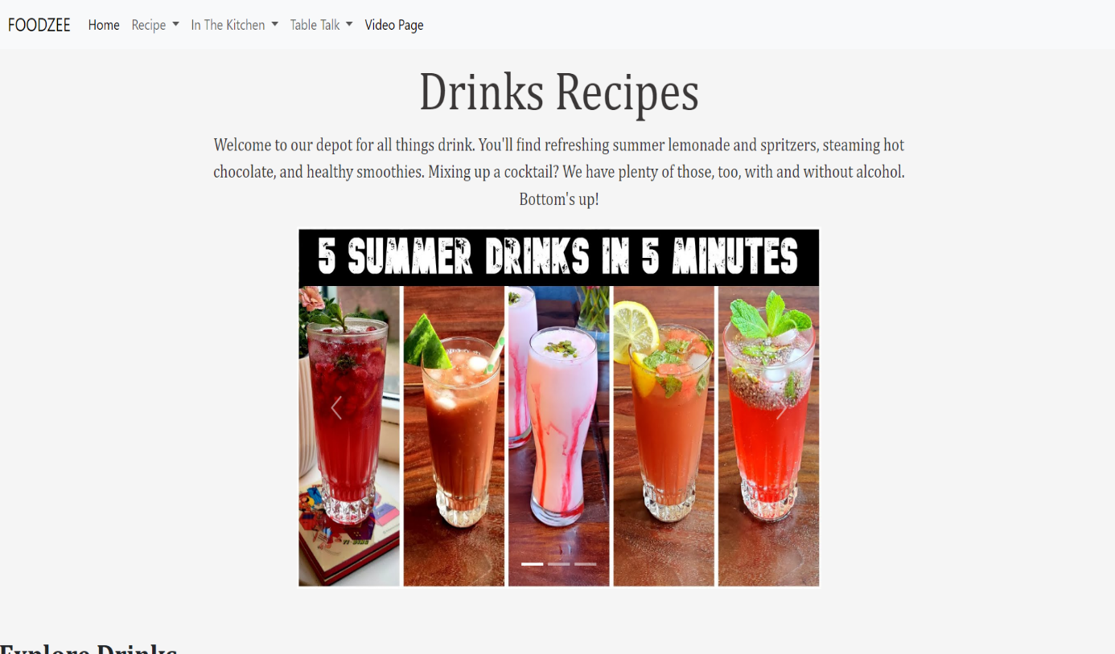
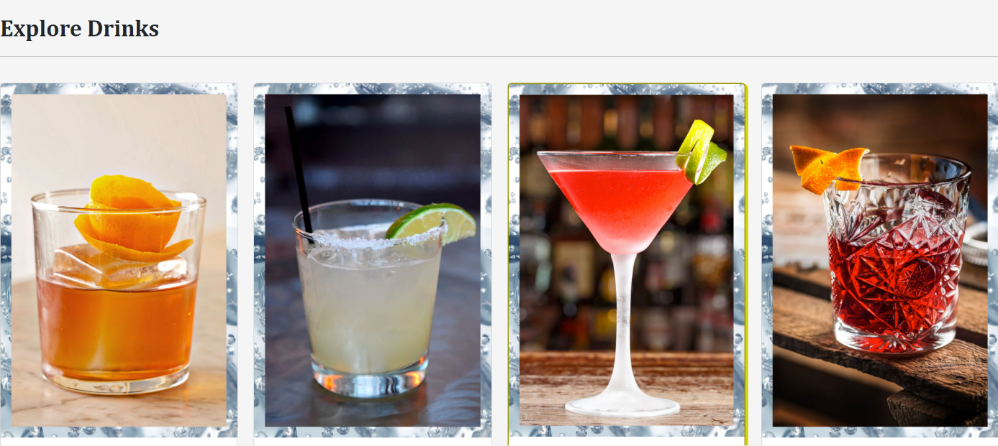
Technical Details

Slide 26
Technical Details
Video Page-:
In the digital age of culinary exploration, where the art of cooking meets the power of visuals, our video recipes page emerges as a captivating and educational corner of our recipe sharing website. This dynamic space is meticulously curated to provide users with an immersive culinary experience, combining the richness of traditional recipes with the accessibility and engagement of video content.
The video recipes page is a visual feast that brings recipes to life with cinematic flair. Each video is a culinary story, artfully narrated through vibrant images, dynamic editing, and step-by-step demonstrations. From the sizzle of ingredients hitting the pan to the final plated masterpiece, users are transported into the heart of the kitchen, making the cooking process more accessible and enjoyable.

Slide 27
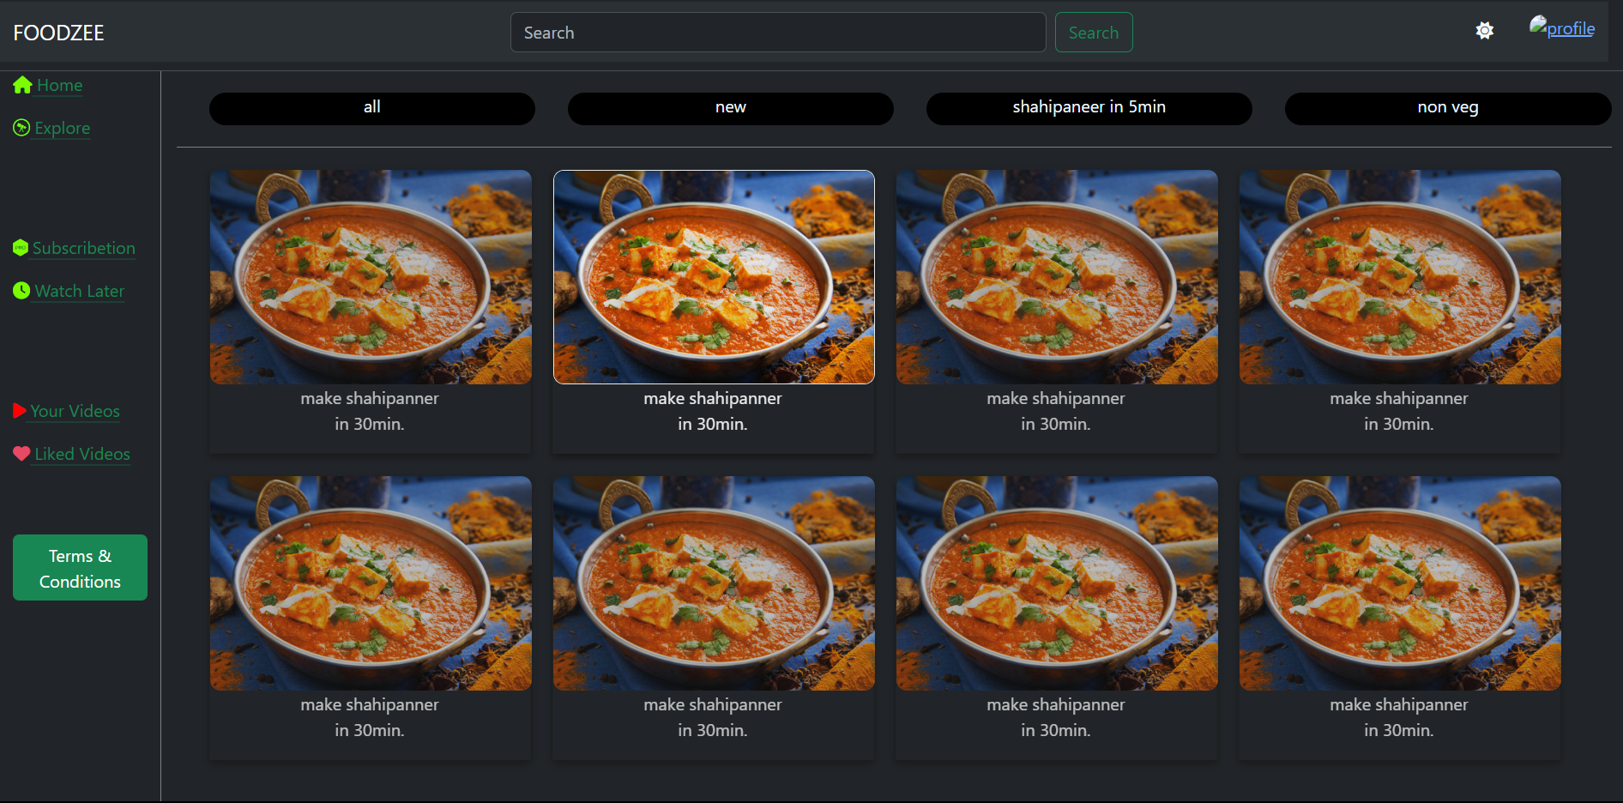
Technical Details

Slide 28
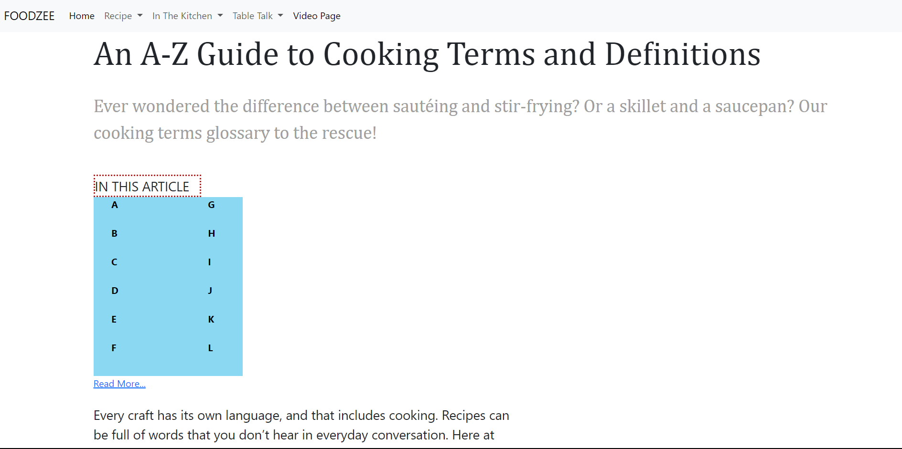
Technical Details
A-Z Page-:
The A-Z Recipe Guide is a virtual roadmap, guiding users through an alphabetical expedition of recipes. From appetizers to desserts, this page encapsulates the culinary spectrum, ensuring that users can discover and indulge in a wide array of dishes. Each letter of the alphabet unfolds a new chapter, inviting users to explore and experiment with recipes they might have never considered.

Slide 29
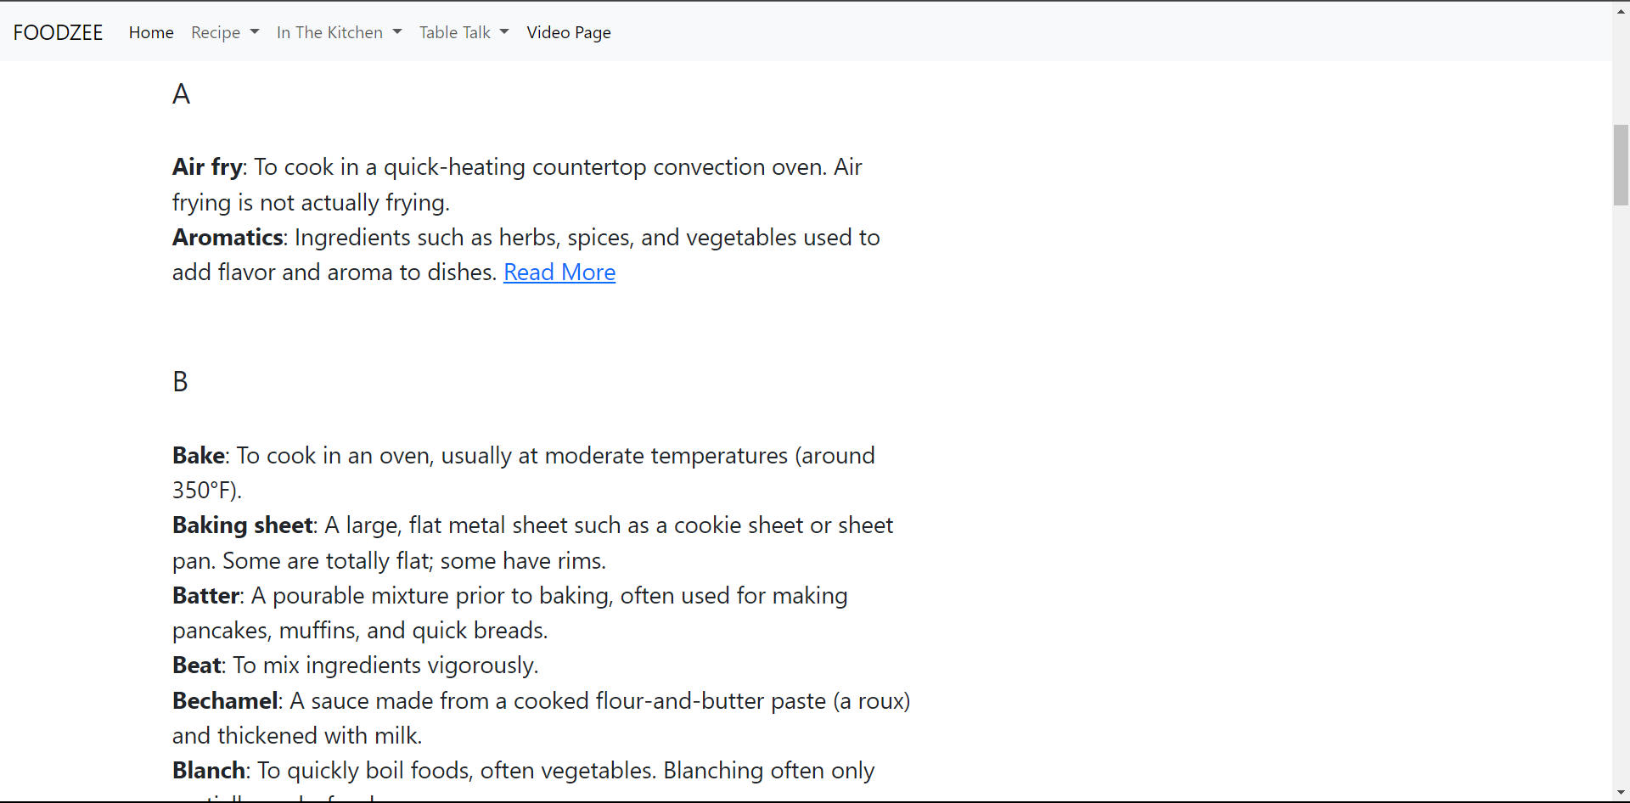
Technical Details

Slide 30
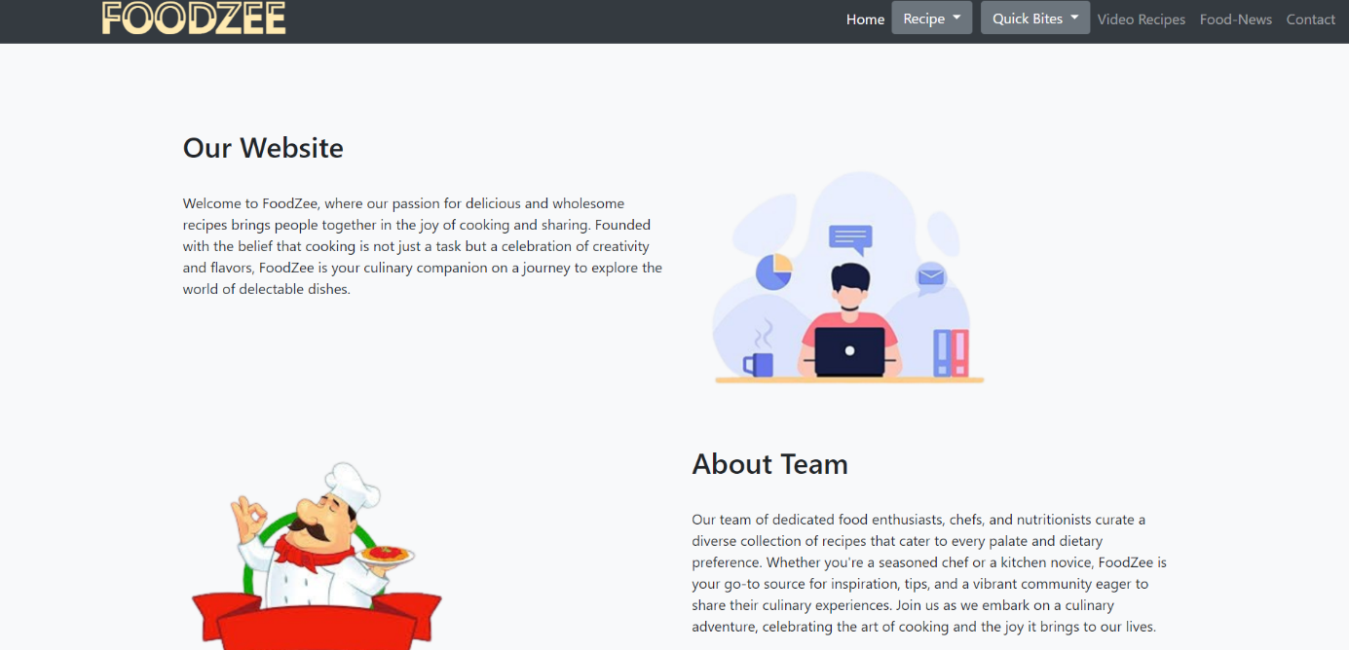
About Us page-:
The only purpose of this page is that viewers should feel free to contact us through emails and our phone numbers so that we would clear their doubts about website.

Slide 31
Key Features
SEARCH BAR: WE HAVE CREATE A SEARCH FUNCTIONALITY TO HELP USERS FIND RECIPES BASED ON INGREDIANTS OR WE CALL RECIPE GENERATOR, THAT IS THEY ONLY HAVE TO WRITE NAME OF THE INGRIDENTS AND IT WILL SHOW YOU ALL POSSIBLE ITEMS MADE UP OF THESE INGRIDENTS.
VIDEO RECIPES: USER CAN NOT ONLY GET WRITTEN RECIPES BUT CAN ALSO VIEW AND POST AMAZINGLY MADE VIDEO RECIPES FROM DIFFERENT PEOPLE.

Slide 32
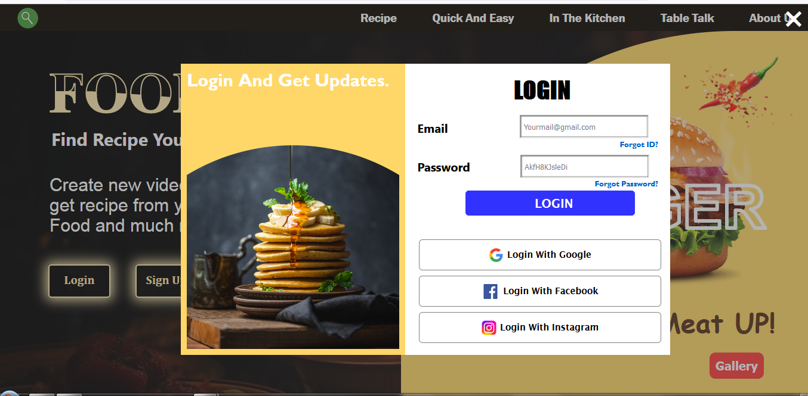
Project Highlights
LOGIN AND SIGNUP SYSTEM-:

Slide 33
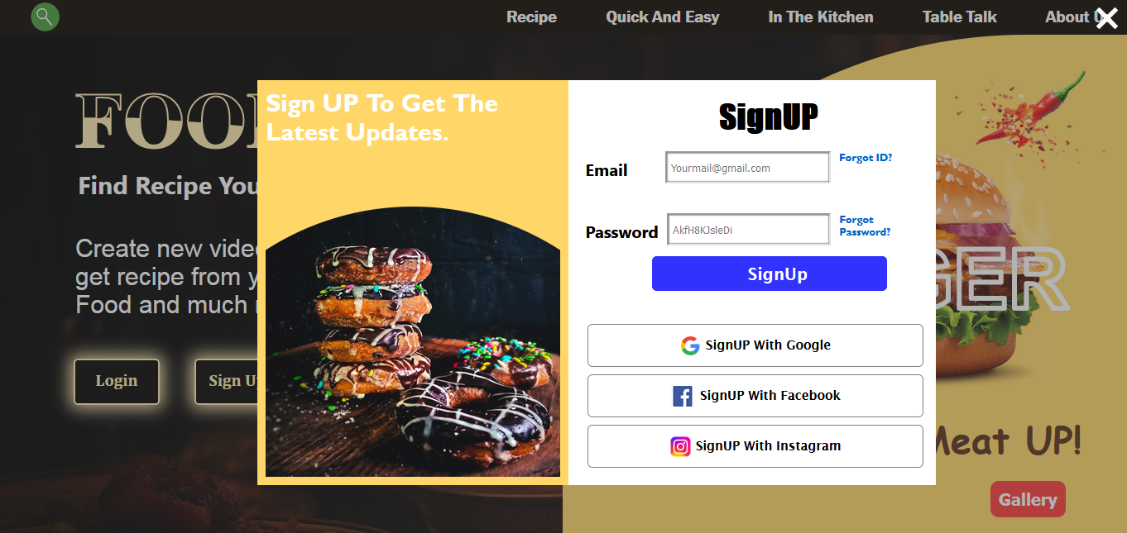
Project Highlights

Slide 34
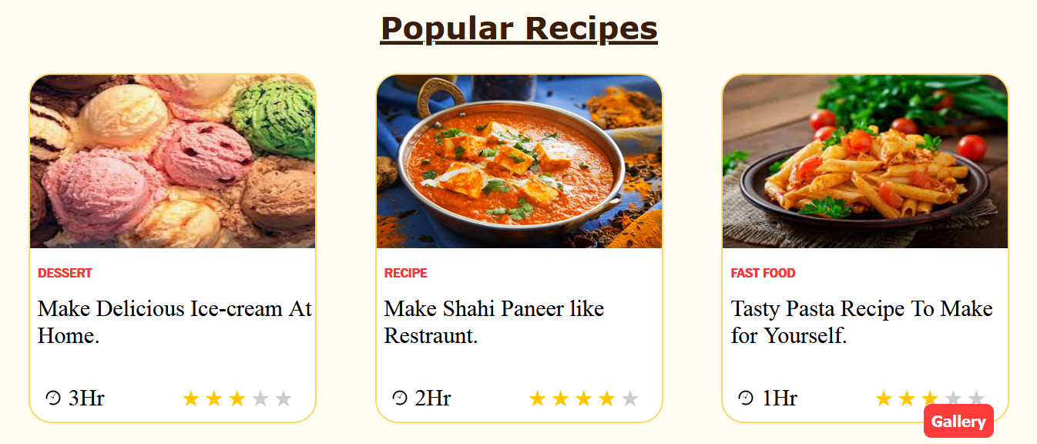
Project Highlights
USER RATINGS :-

Slide 35
Bonus Features
Add a favorite button for user to save recipes to there personal collections.
Implement a recipe rating system with stars so users can help other users to recognize a good recipe.
Include social media sharing options for user to share recipes . This will help users to easily recommend a recipe to others.
ADVANCED SEARCH FILTERS-:
Enhance the search functionality with filters for seasonality, cost, and specific dietary requirements. Filter feature adds an interactive yet easier method to filter through a variety of recipes . User can filter recipe type their difficulty level and dietary preferences.

Slide 36
Conclusion
In conclusion, a recipe sharing platform website provides a valuable space for culinary enthusiasts to come together, exchange ideas, and explore the rich world of food. It fosters a sense of community, encourages creativity in the kitchen, and allows individuals to discover and share their favorite dishes with a global audience.
Our team is very thankful to be given such an amazing project . This helped us to deeply understand the vast subject of food and its related Topics . We gained a deep knowledge about Html , CSS, Javascript.

Slide 37
References/Links used
LIST OF REFERENCES
W3 SCHOOLS-: https://www.w3schools.com/
GOOGLE-: https://www.google.com/
SIMPLY RECIPES-: https://www.simplyrecipes.com/
BENNETTFEELY-: https://bennettfeely.com/clippy/
CANVA: Canva: Visual Suite for Everyone

Slide 38


